Slide 1

~ Curve Fitting ~
Least Squares Regression
Chapter 17

Slide 2
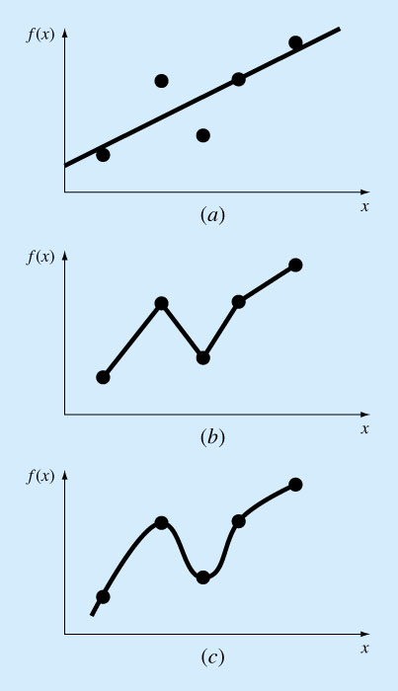
Curve Fitting
Fit the best curve to a discrete data set and obtain estimates for other data points
Two general approaches:
  Data exhibit a significant degree of scatter Find a single curve that represents the general trend of the data.
  Data is very precise. Pass a curve(s) exactly through each of the points.
Two common applications in engineering:
  Trend analysis. Predicting values of dependent variable: extrapolation beyond data points or interpolation between data points.
  Hypothesis testing. Comparing existing mathematical model with measured data.

Slide 3
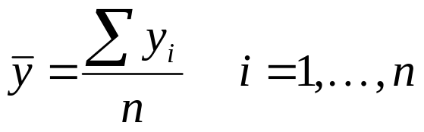
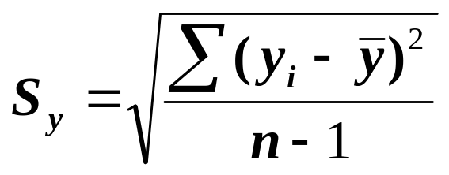
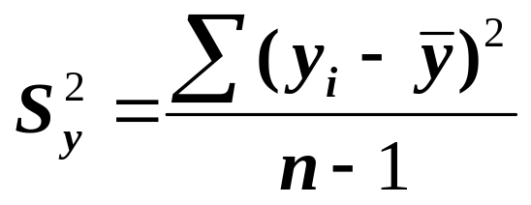
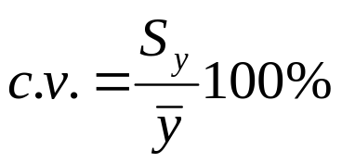
Simple Statistics
In sciences, if several measurements are made of a particular quantity, additional insight can be gained by summarizing the data in one or more well chosen statistics:
Arithmetic mean - The sum of the individual data points (y_{i}) divided by the number of points.
Standard deviation – a common measure of spread for a sample
or variance
Coefficient of variation –
quantifies the spread of data (similar to relative error)

Slide 4
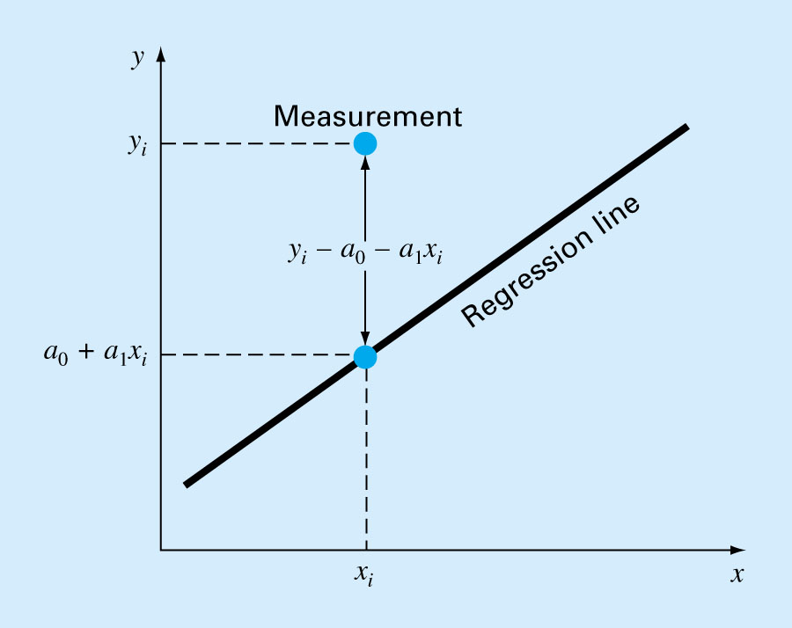
Linear Regression
Fitting a straight line to a
set of paired observations:
(x₁, y₁), (x₂, y₂),…,(x_{n}, y_{n})
y_{i} : measured value
e : error
y_{i} = a₀ + a₁ x_{i} + e
e = y_{i} - a₀ - a₁ x_{i}
a₁ : slope
a₀ : intercept
e Error
Line equation
y = a₀ + a₁ x

Slide 5
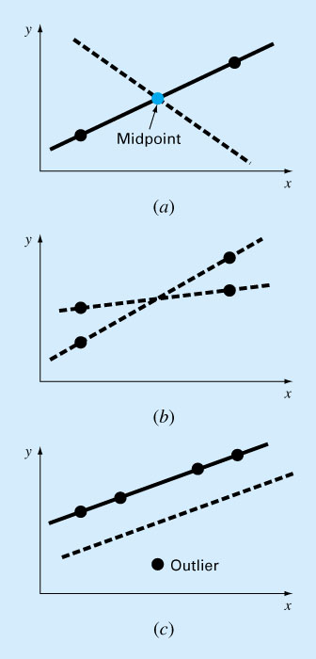
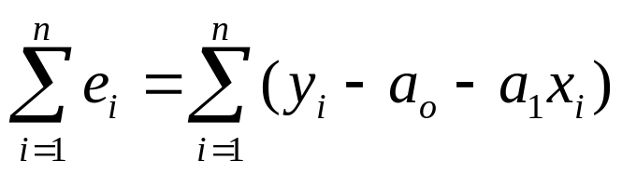
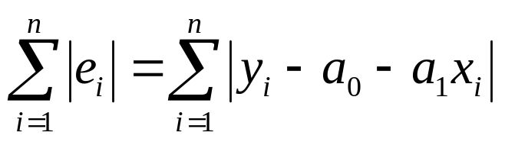
Choosing Criteria For a “Best Fit”
Minimize the sum of the residual errors for all available data?
Inadequate!
(see ➔➔➔)
Sum of the absolute values?
Inadequate!
(see ➔➔➔)
How about minimizing the distance that an individual point falls from the line?
This does not work either! see ➔➔➔
Regression
line

Slide 6
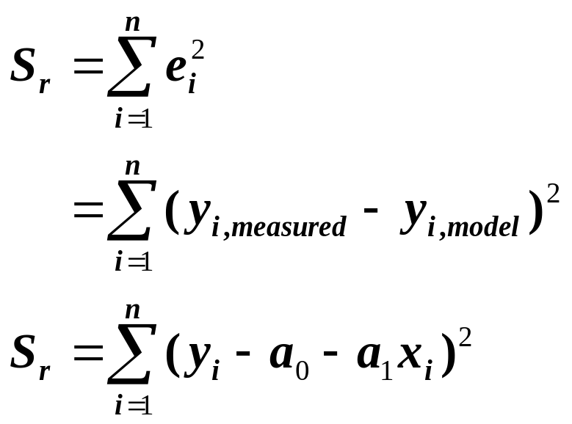
Best strategy is to minimize the sum of the squares of the residuals between the measured-y and the y calculated with the linear model:
Yields a unique line for a given set of data
Need to compute a₀ and a₁ such that S_{r} is minimized!
e Error

Slide 7
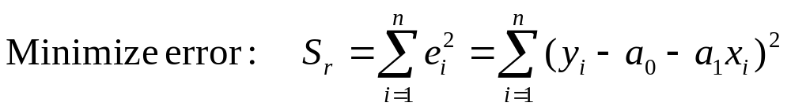
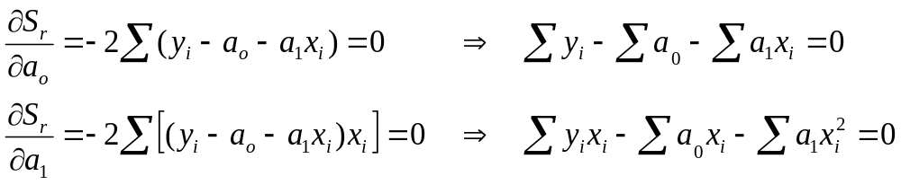
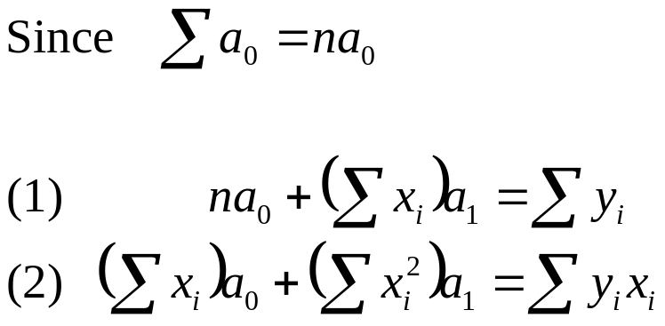
Least-Squares Fit of a Straight Line
Normal equations which can be solved simultaneously

Slide 8
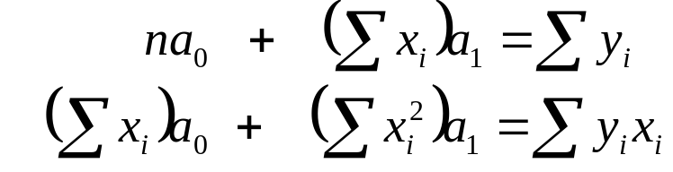
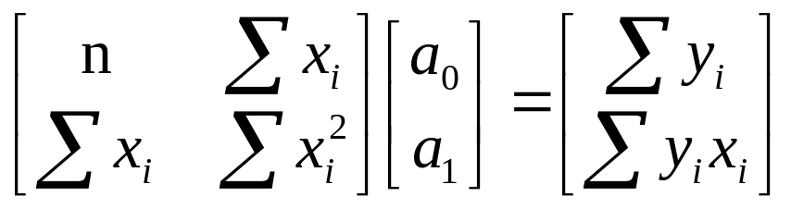
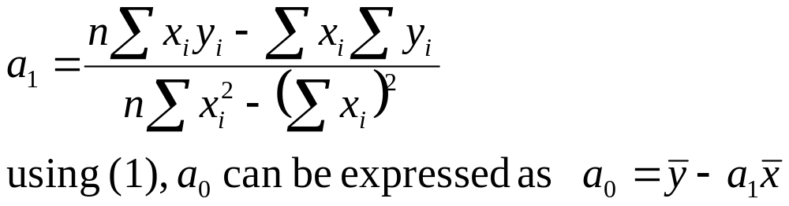
Least-Squares Fit of a Straight Line
Normal equations which can be solved simultaneously
Mean values

Slide 9
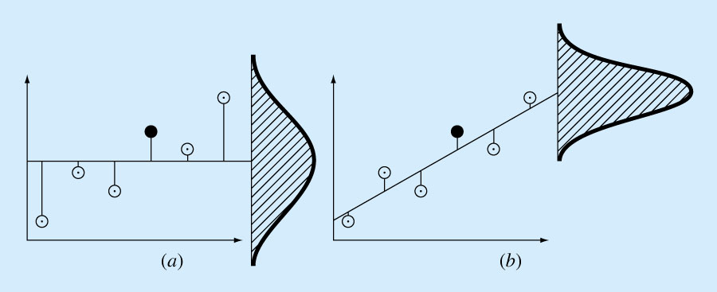
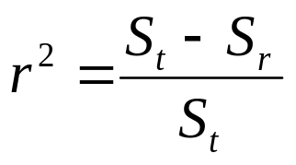
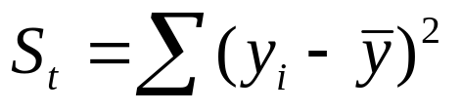
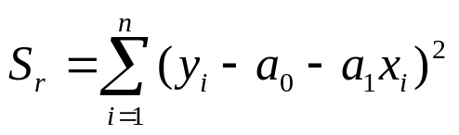
“Goodness” of our fit
The spread of data
around the mean
around the best-fit line
Notice the improvement in the error due to linear regression
S_{r} = Sum of the squares of residuals around the regression line
S_{t} = total sum of the squares around the mean
(S_{t} – S_{r}) quantifies the improvement or error reduction due to describing data in terms of a straight line rather than as an average value.
For a perfect fit S_{r}=0 and r = r² = 1
signifies that the line explains 100 percent of the variability of the data.
For r = r² = 0 ➔ S_{r}=S_{t} ➔ the fit represents no improvement
r : correlation coefficient

Slide 10
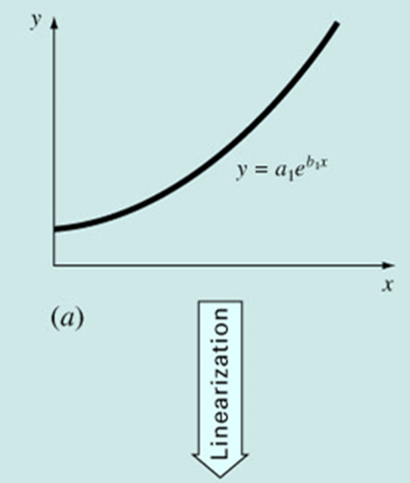

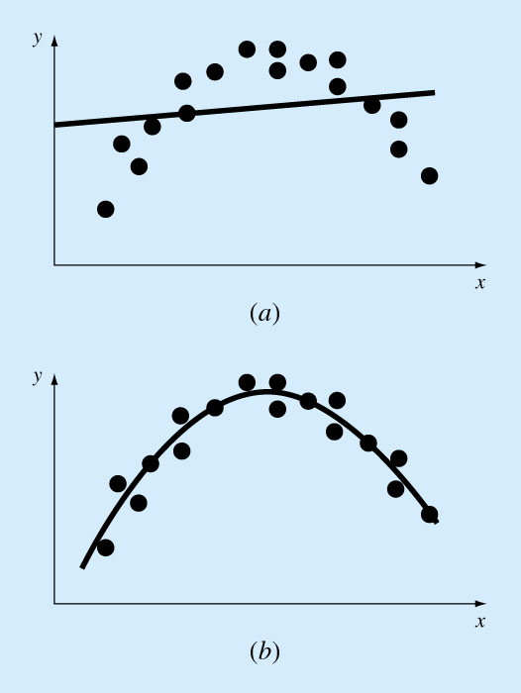
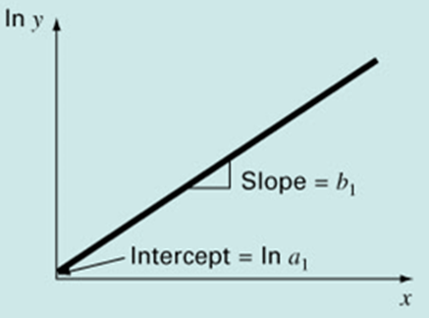


Linearization of Nonlinear Relationships
Data that is ill-suited for linear least-squares regression
Indication that a parabola may be more suitable
Exponential Eq.

Slide 11
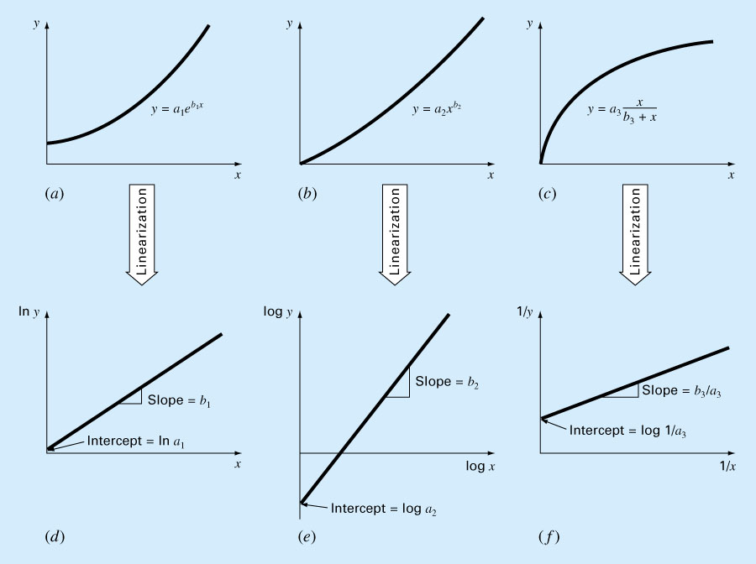
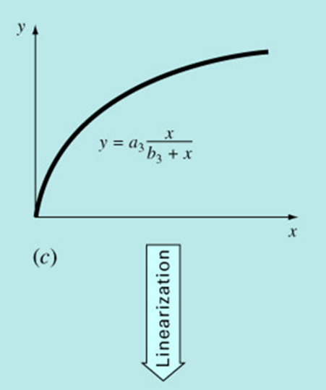
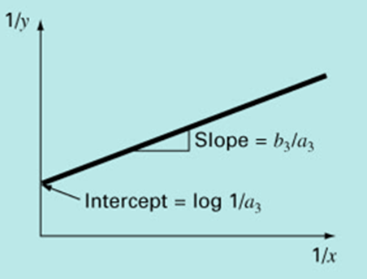
Linearization of Nonlinear Relationships
Power Eq.
Saturation
growth-rate Eq.

Slide 12
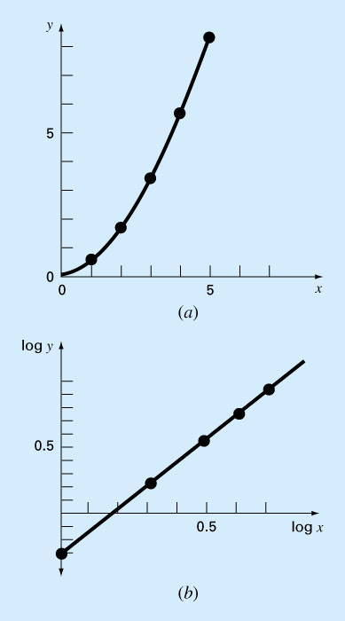
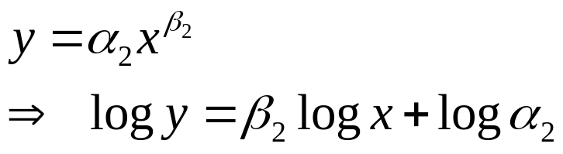
Data to be fit to the power equation:
x | y
1 | 0.5
2 | 1.7
3 | 3.4
4 | 5.7
5 | 8.4
log x
0
0.301
0.477
0.602
0.699
log y
-0.301
0.226
0.531
0.756
0.924
Linear Regression yields the result:
log y = 1.75*log x – 0.300
β₂ = 1.75 log α₂ = - 0.3➔ α₂ = 0.5
y = 0.5 x^{1.75}
See Exercises.xls
After (log y)–(log x) plot is obtained
Find α₂ and β₂ using:

Slide 13
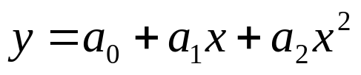
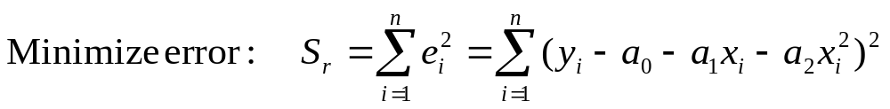
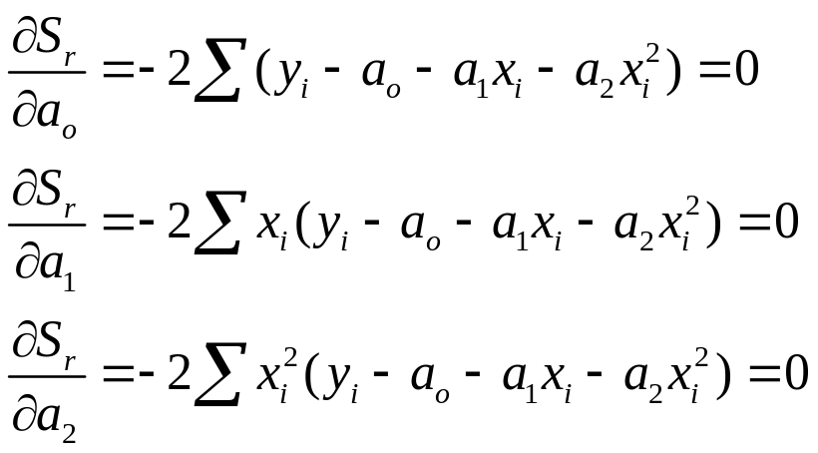
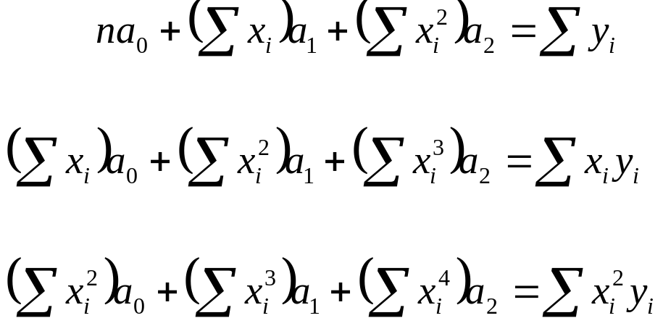
Polynomial Regression
Some engineering data is poorly represented by a straight line. A curve (polynomial) may be better suited to fit the data. The least squares method can be extended to fit the data to higher order polynomials.
As an example let us consider a second order polynomial to fit the data points:

Slide 14
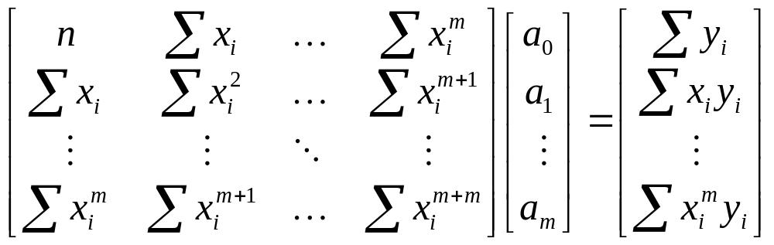
Polynomial Regression
To fit the data to an m^{th} order polynomial, we need to solve the following system of linear equations ((m+1) equations with (m+1) unknowns)
Matrix Form

Slide 15
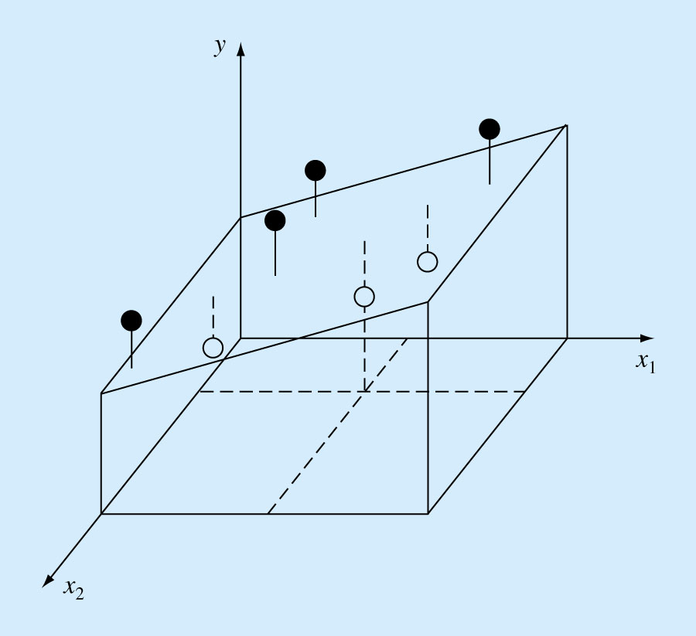
Multiple Linear Regression
A useful extension of linear regression is the case where y is a linear function of two or more independent variables. For example:
y = a_{o} + a₁x₁ + a₂x₂
For this 2-dimensional case, the regression line becomes a plane as shown in the figure below.

Slide 16
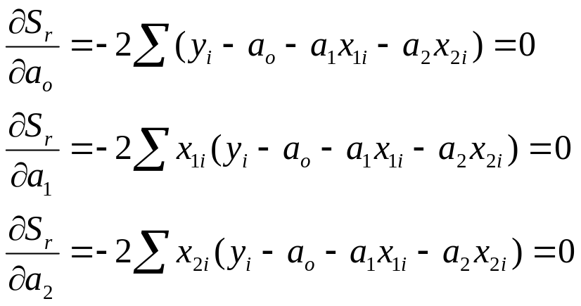
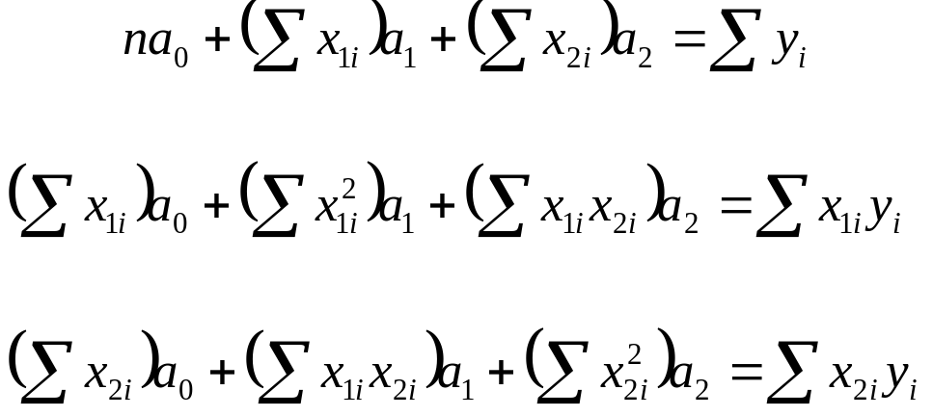
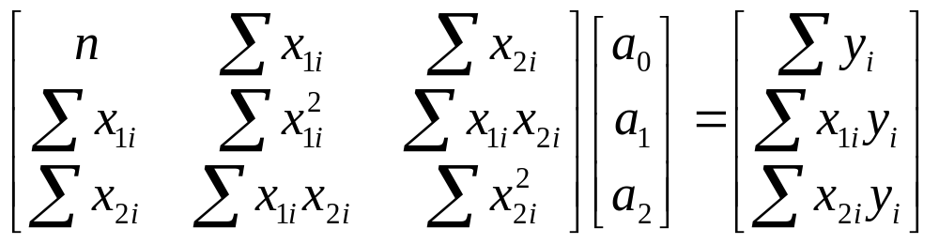
Multiple Linear Regression
Which method would you use to solve this Linear System of Equations?

Slide 17
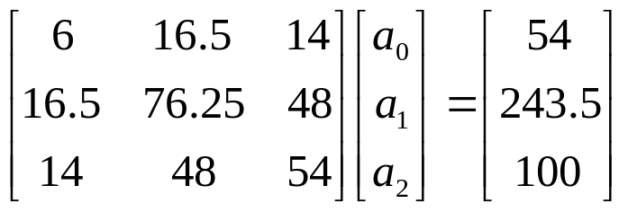
Multiple Linear Regression
Example 17.6
The following data is calculated from the equation y = 5 + 4x₁ - 3x₂
Use multiple linear regression to fit this data.
Solution:
this system can be solved using
Gauss Elimination.
The result is: a₀=5 a₁=4 and a₂= -3
y = 5 + 4x₁ -3x₂
x₁ | x₂ | y
0 | 0 | 5
2 | 1 | 10
2.5 | 2 | 9
1 | 3 | 0
4 | 6 | 3
7 | 2 | 27

